Slide 1
WoRKFLOW
SHAKTHI PRIYA P
HEMAVATHY R

Slide 2
ABSTRACT
This project aims to perform workflow using spring boot.
Users can register and login to the application and post their jobs.
Users can also view other users and assign jobs to them while they are posting the job.
The user to whom the job is assigned can either accept or reject the job.
If the user is rejecting the job, he/she can edit the job and assign the job to someone else.
Finally, the user sign out from the application.
Project Presentation recording :https://fluvid.com/videos/detail/4XaD5tQZ7QHOz-21G

Slide 3
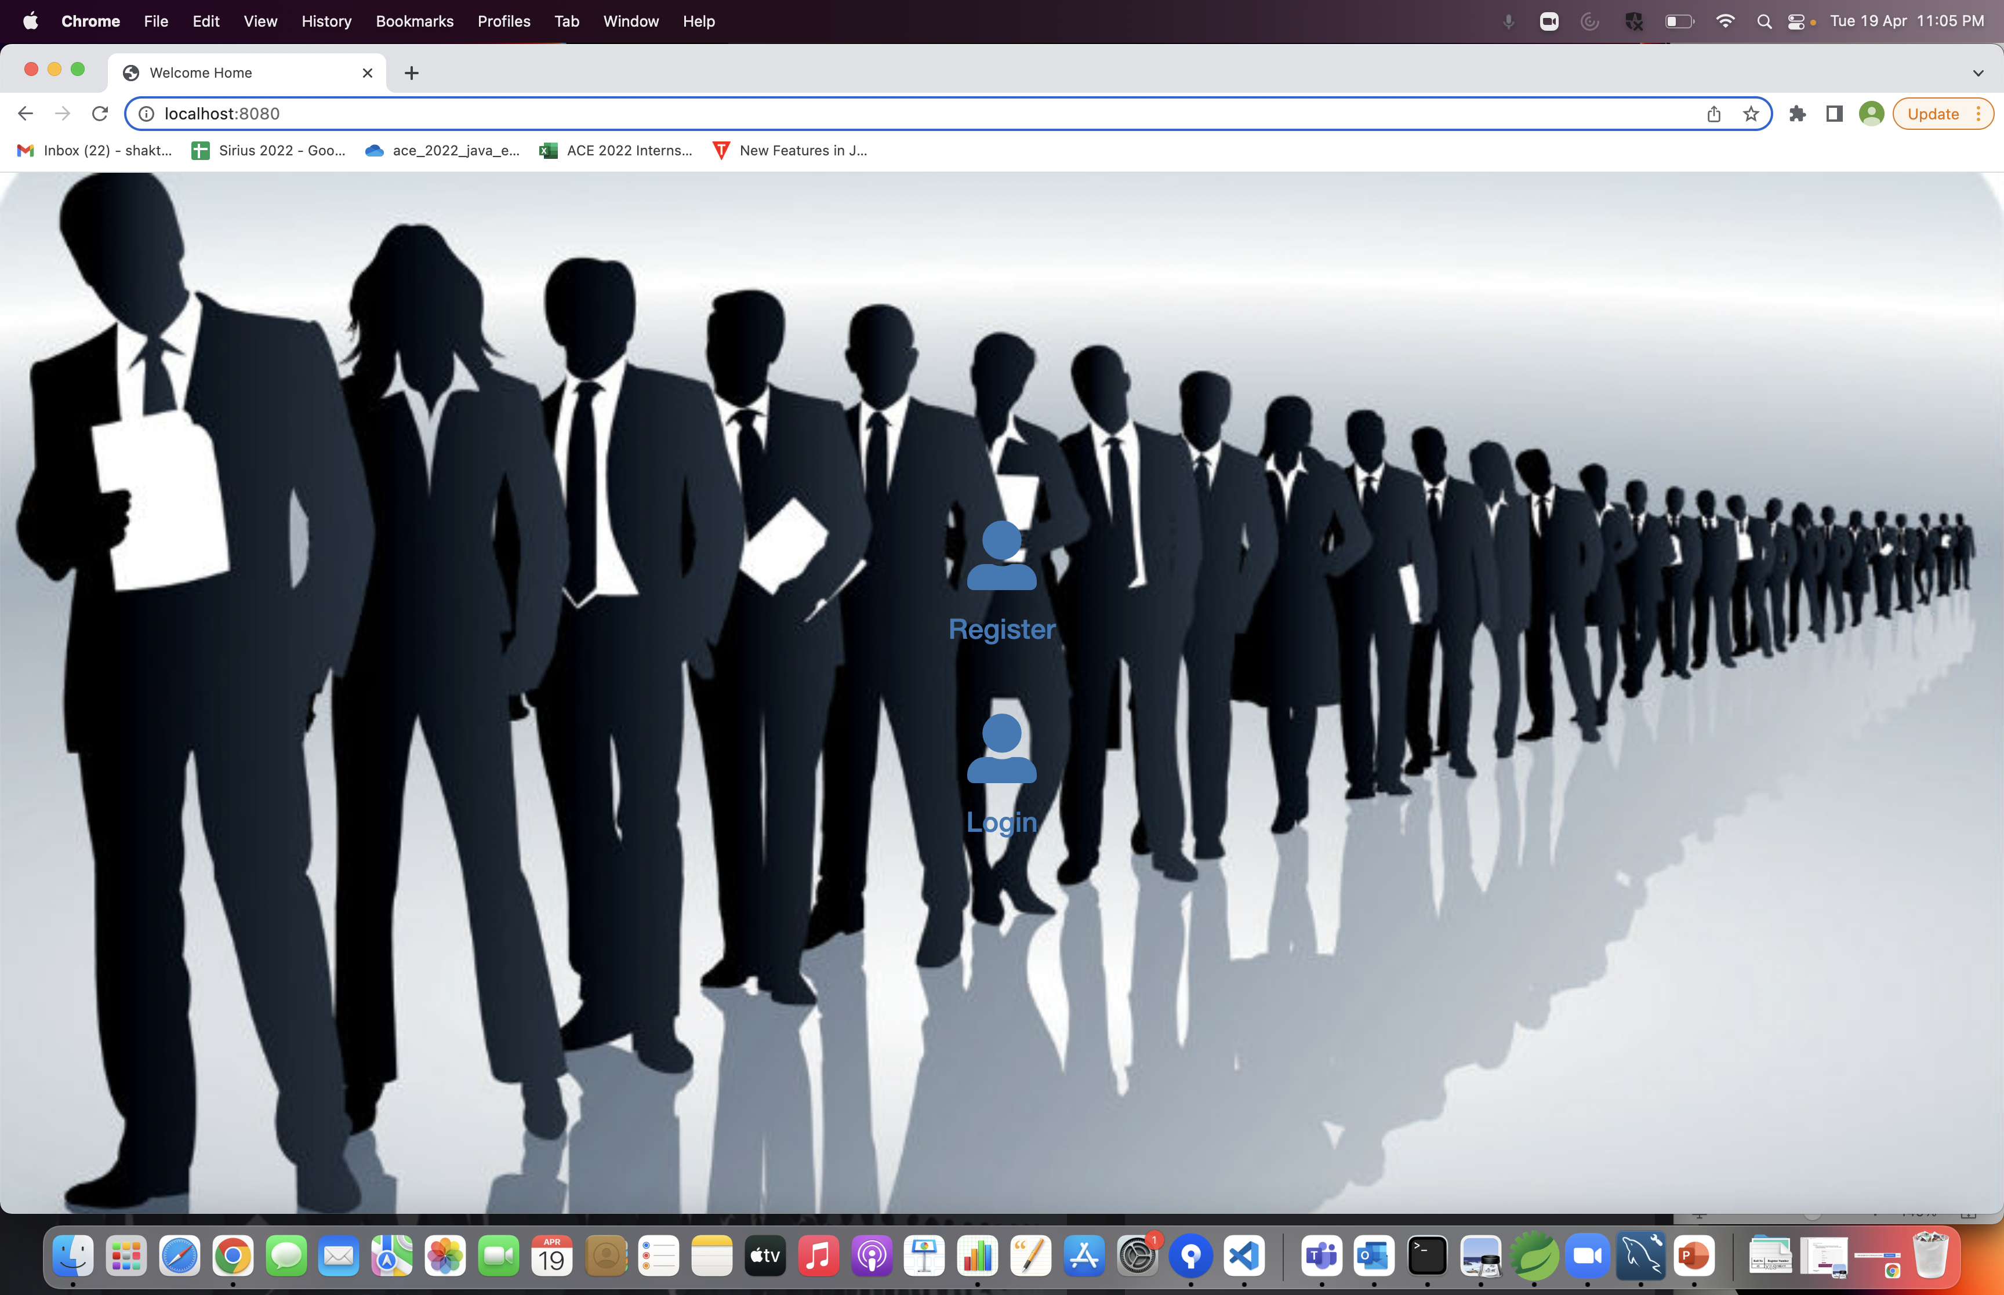
Home page

Slide 4

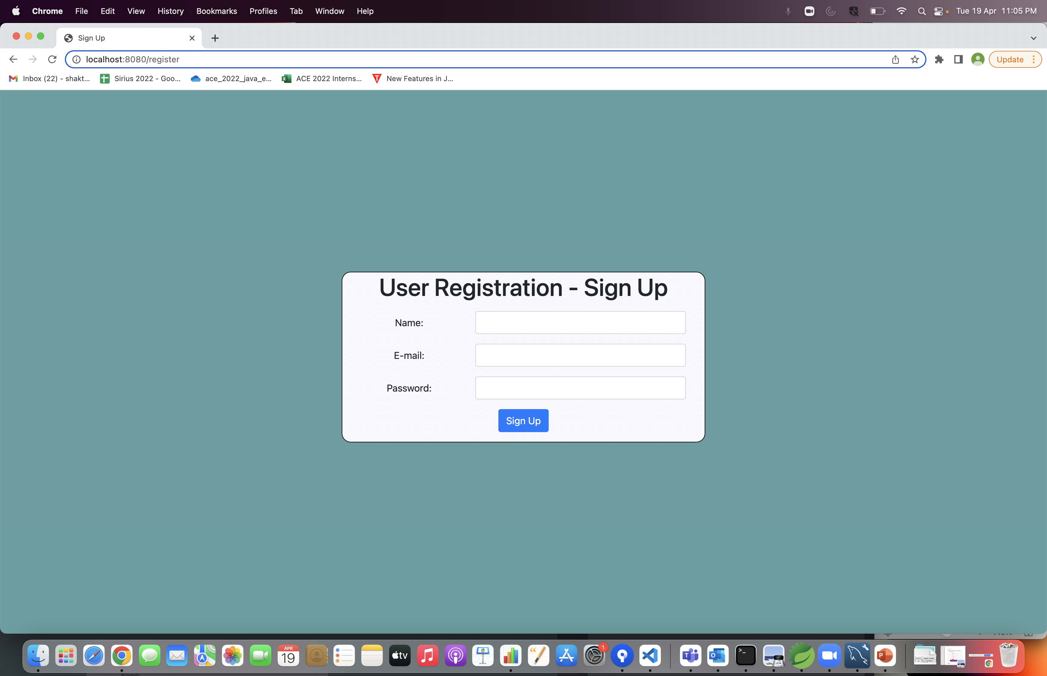
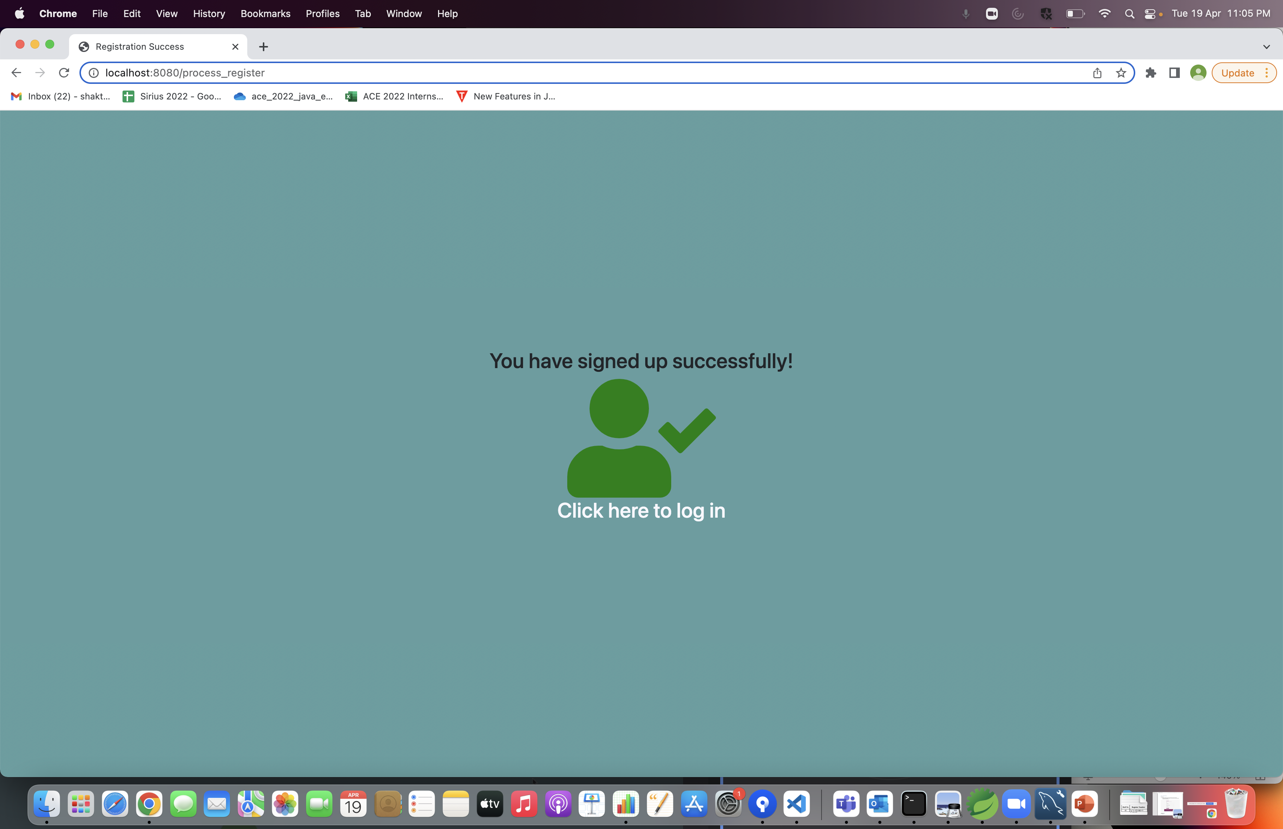
Register & Success Page

Slide 5


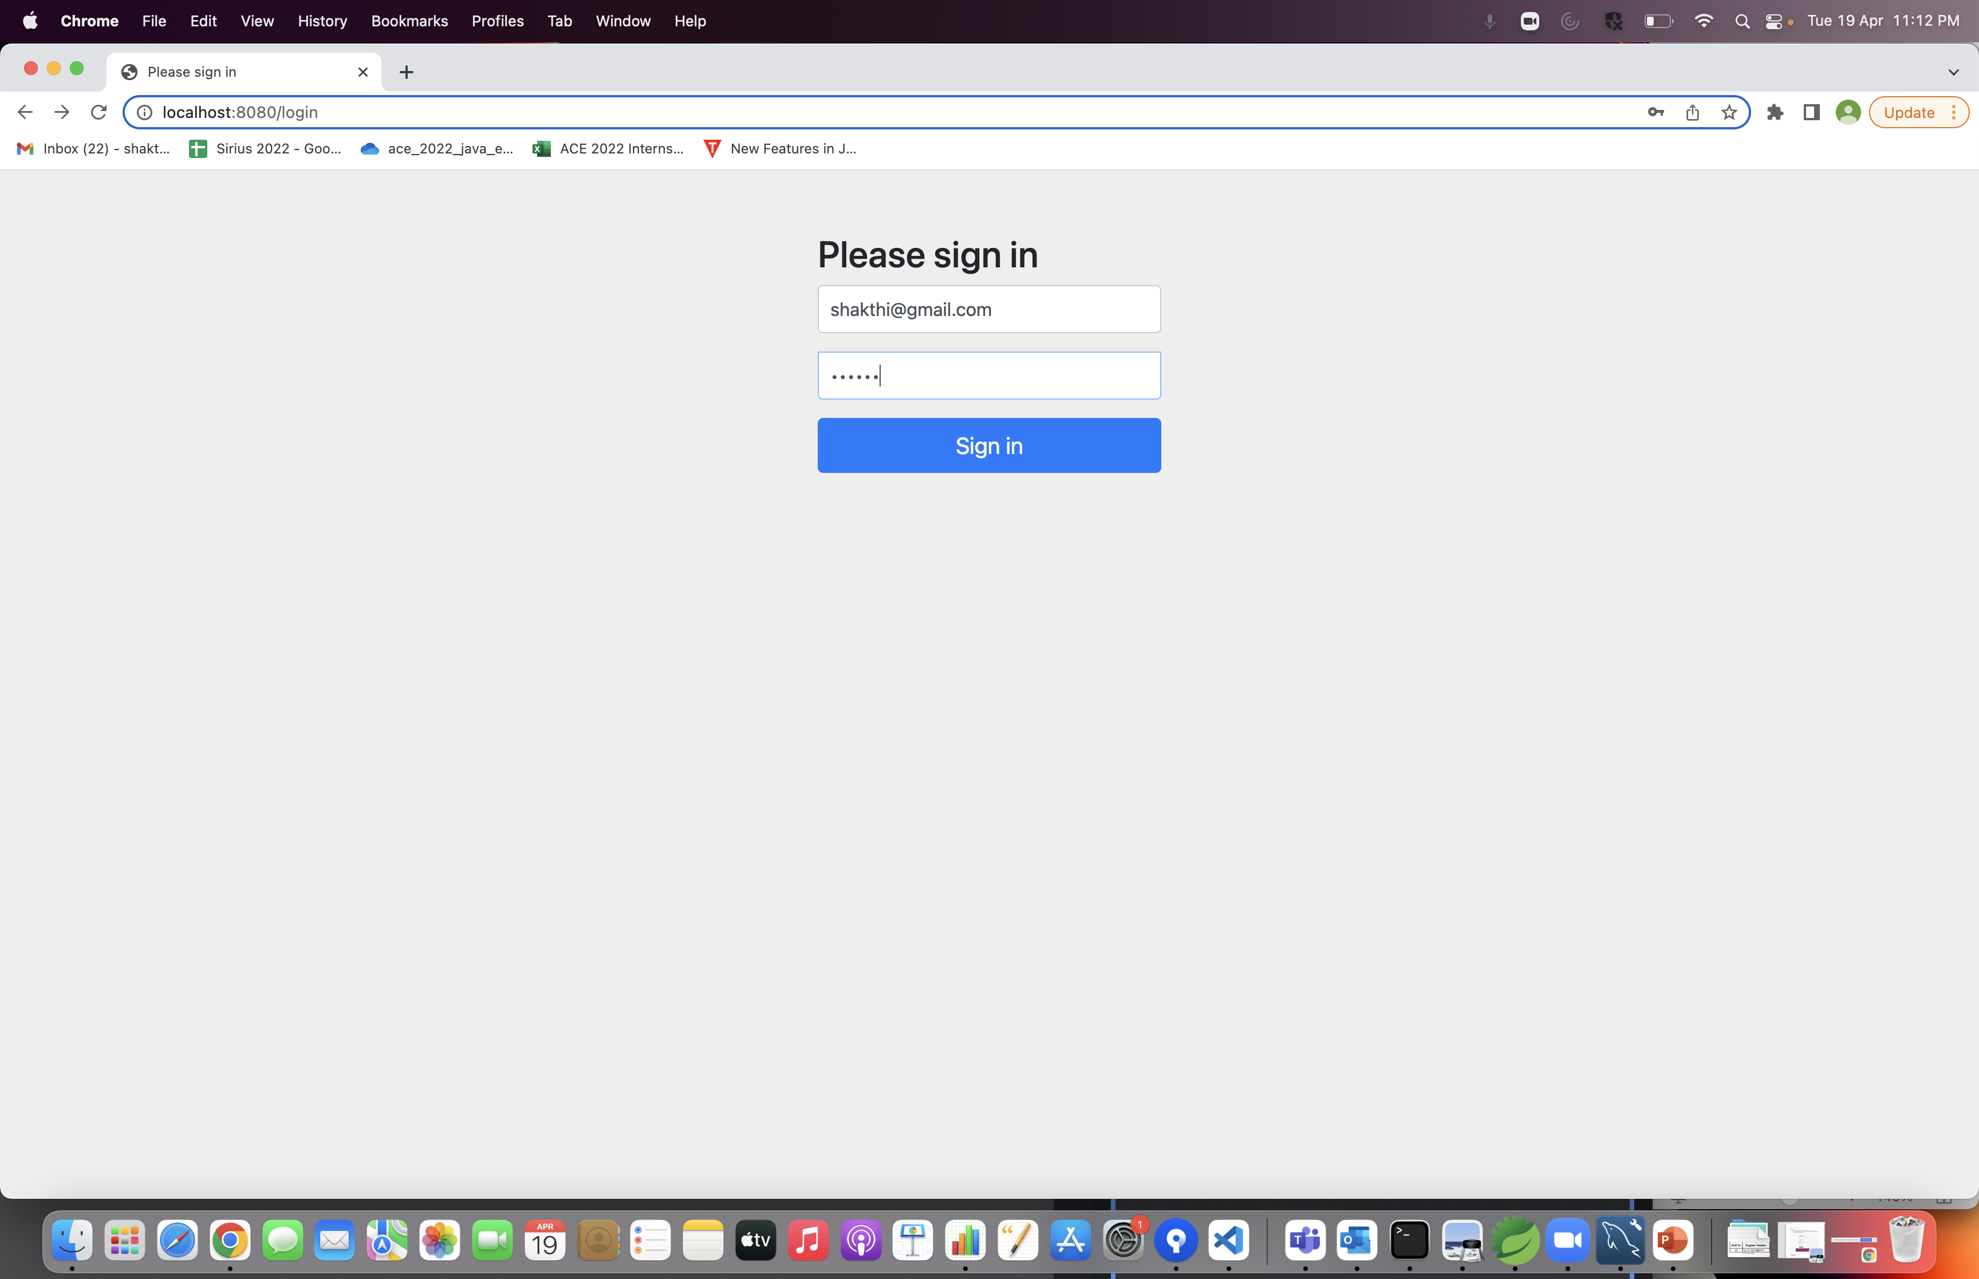
Login

Slide 6
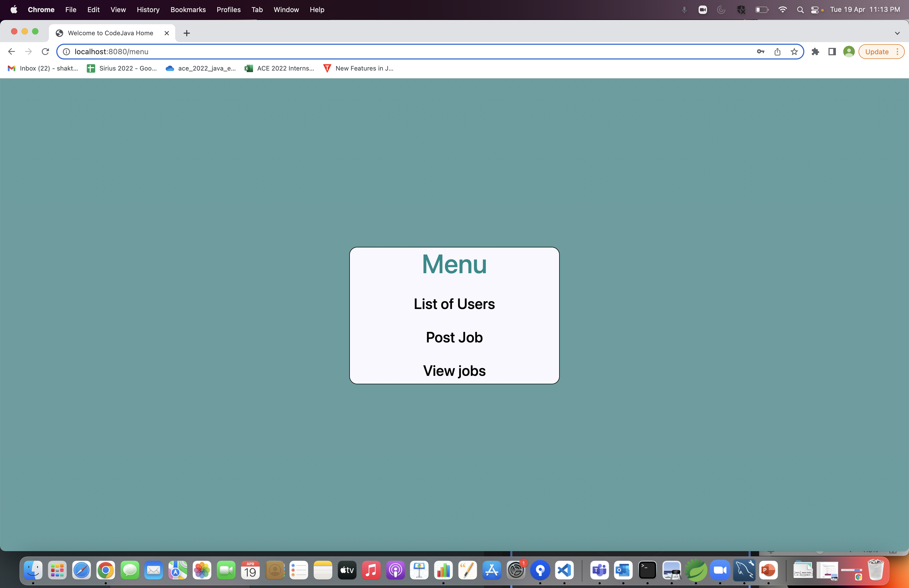
Menu

Slide 7
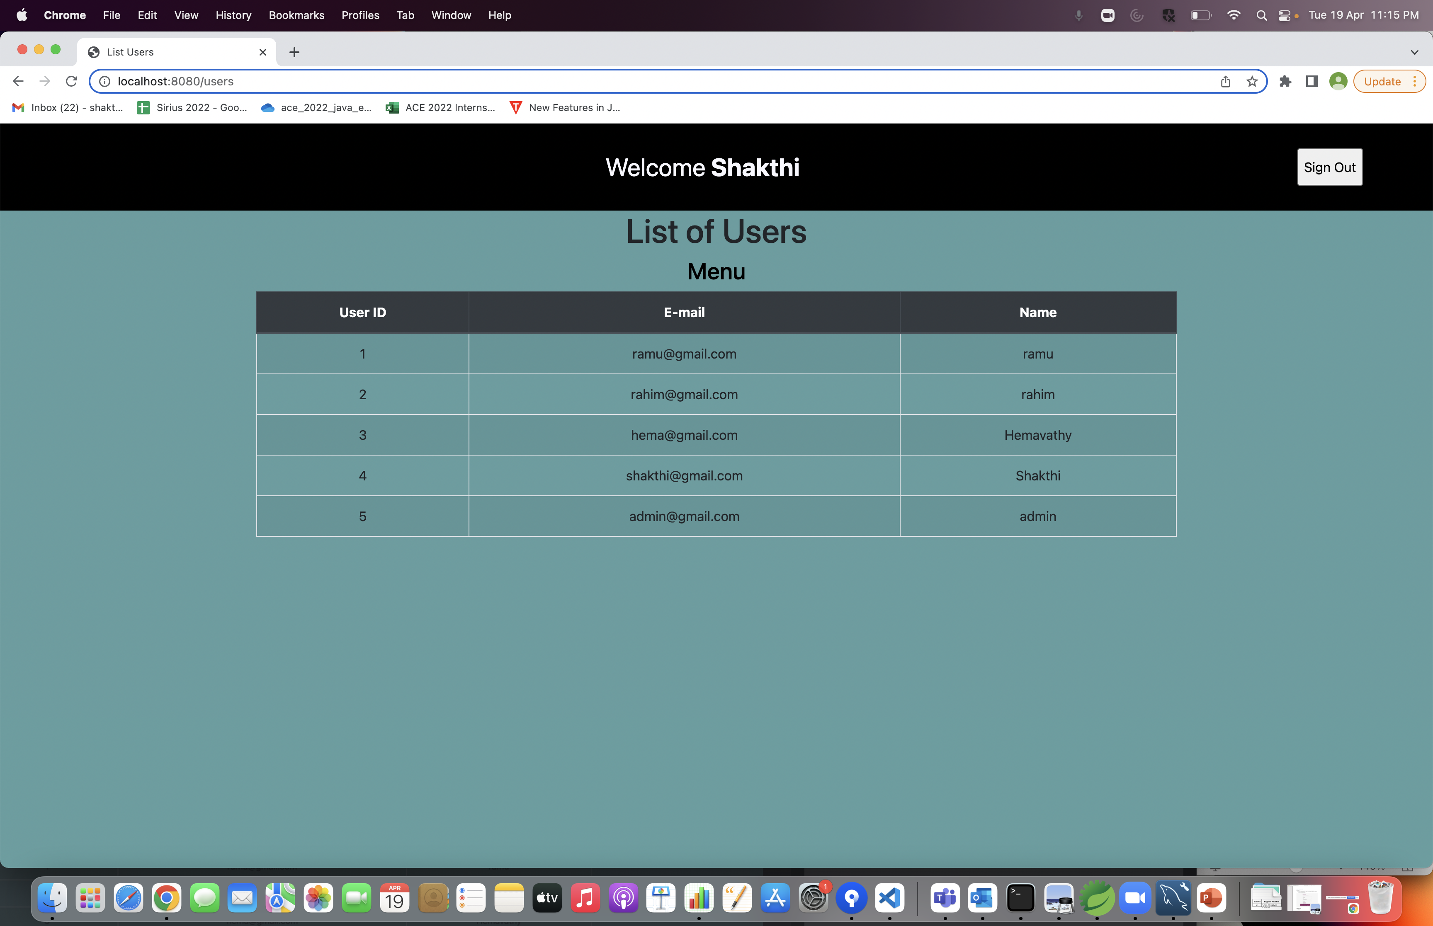
Users

Slide 8
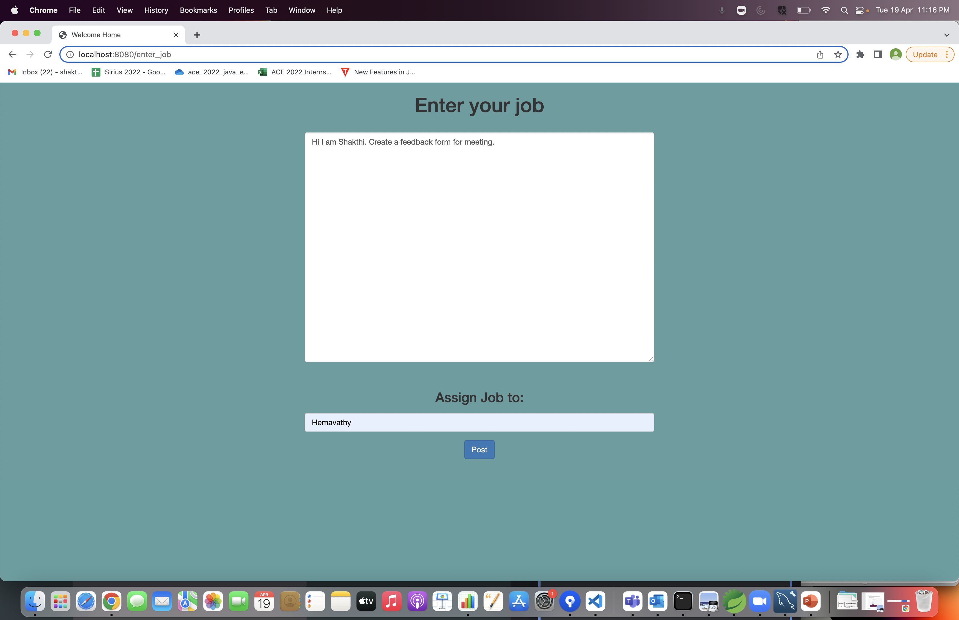
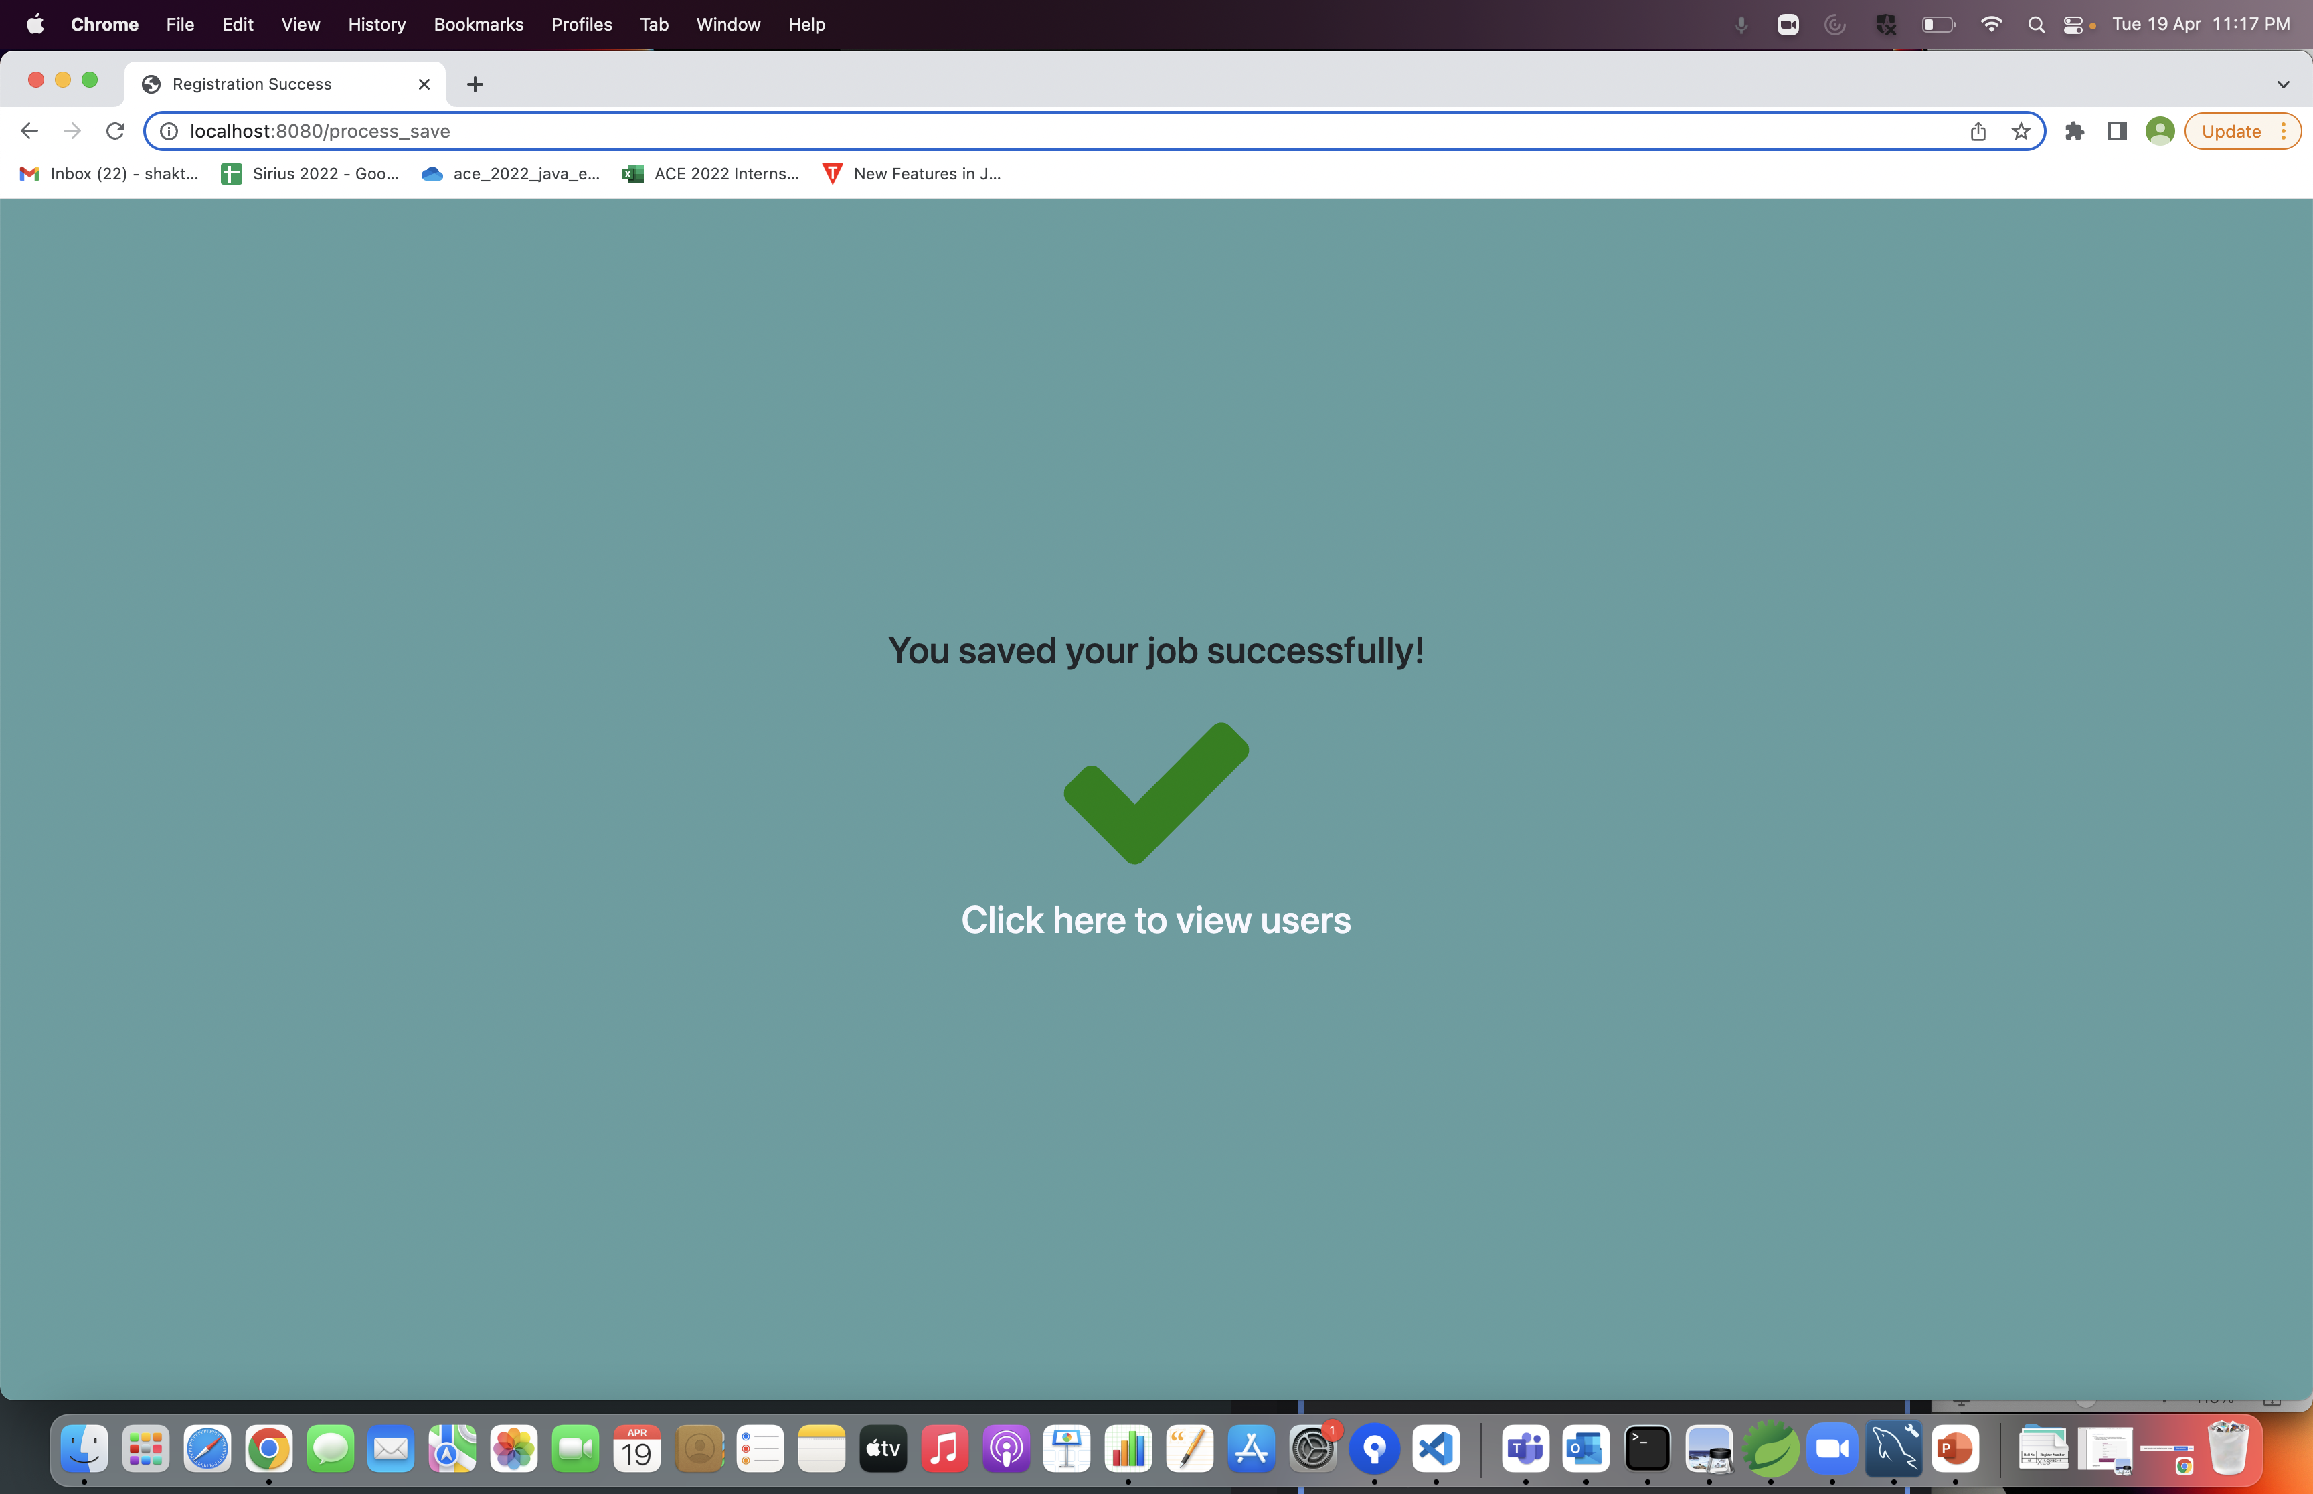
Enter Job

Slide 9
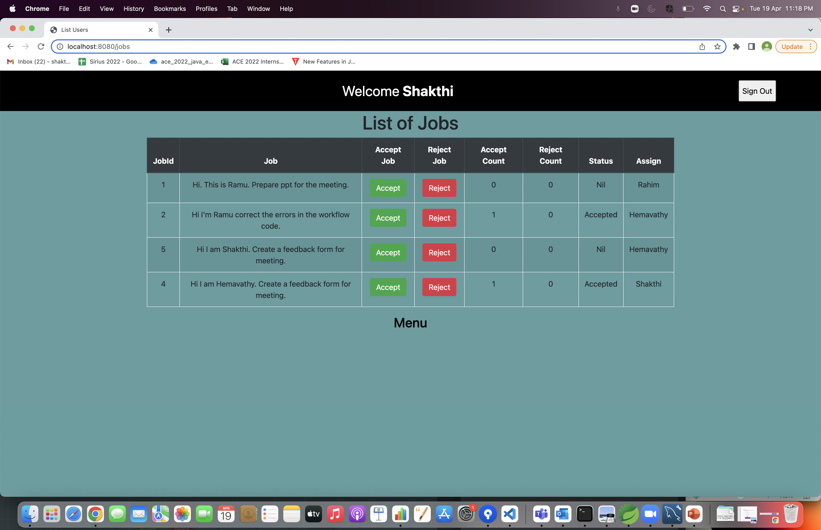
View jobs

Slide 10


